Slide 1
ME751 Advanced Computational Multibody Dynamics
Solution of the Dynamics Analysis Problem
(using BDF implicit integration)
April 08, 2010
"Everything in moderation, including moderation."
Oscar Wilde
© Dan Negrut, 2010 ME751, UW-Madison

Slide 2
Before we get started…
Last Time:
BDF Methods (one of several families of implicit numerical integration methods)
Dealing with 2nd order IVPs
Today:
Use BDF Methods to Solve the Dynamics Analysis problem
HW – posted later today
Last HW with SimEngine3D related MATLAB code *unless* you made SimEngine3D be your Final Project
Exam coming up on April 29, 7:15 PM
Closed books (no book to open anyway)
Can bring one normal sheet of paper with formulas (both sides)
I’ll provide the cheat sheet that you received a while ago
Trip to John Deere & NADS:
Need head count by today

Slide 3
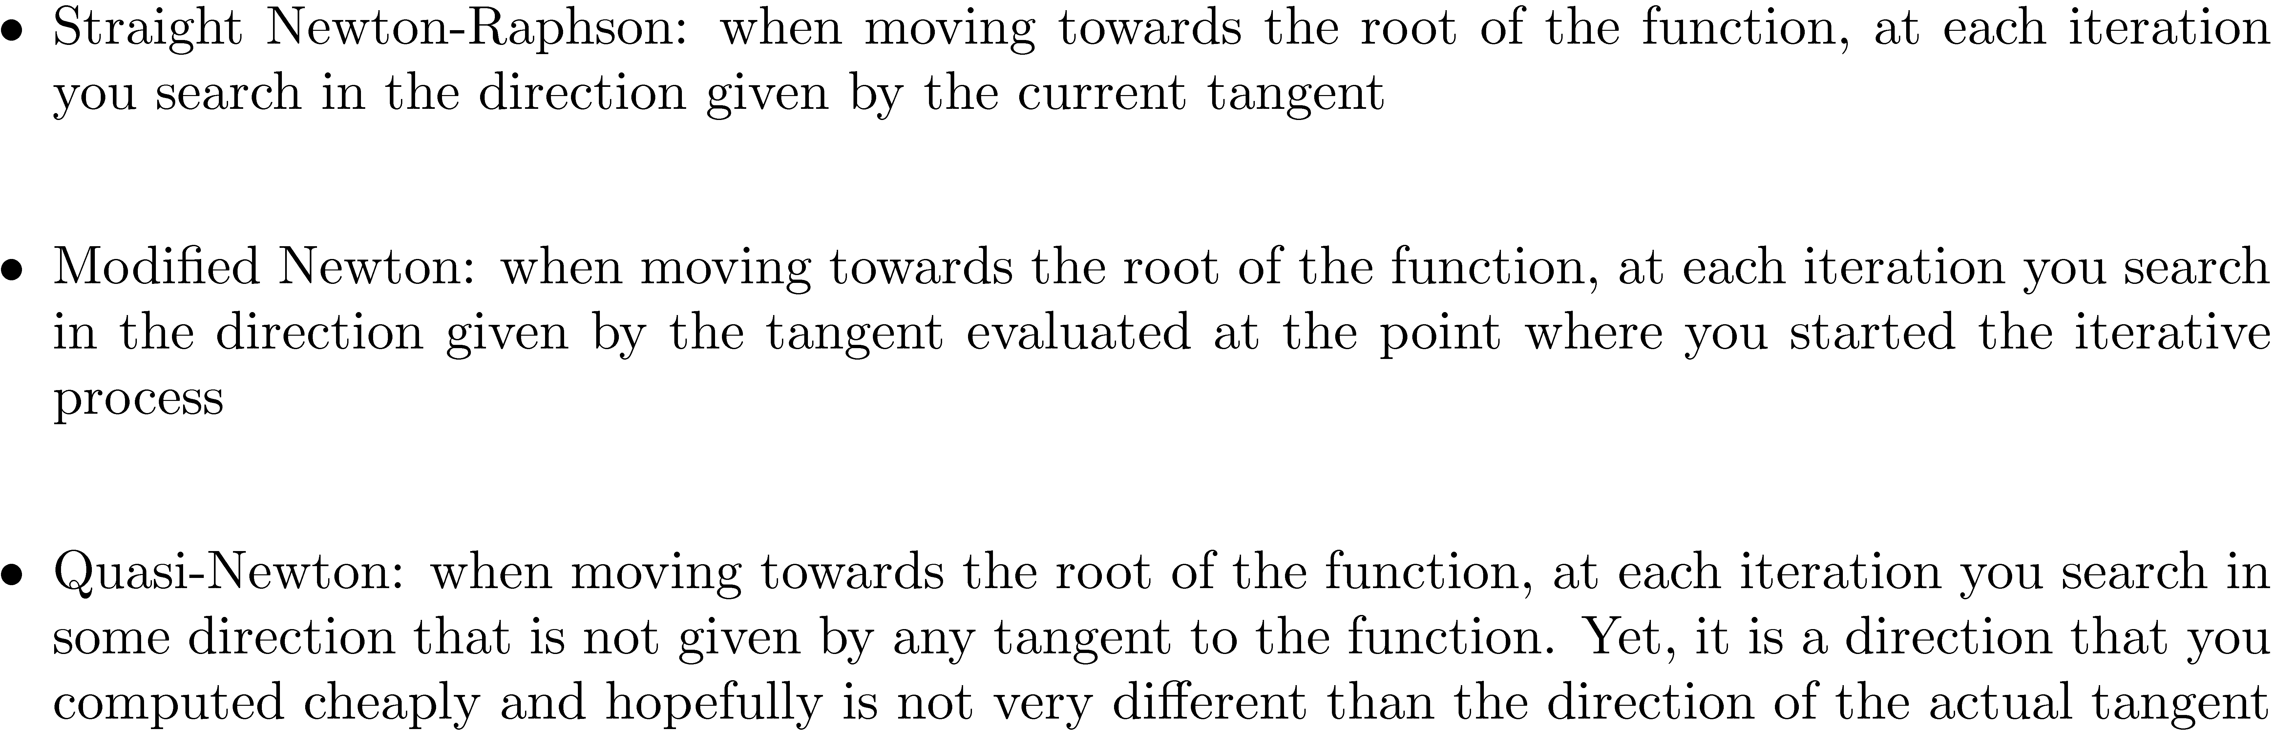
Newton-Type Methods: [Geometric Interpretation]

Slide 4
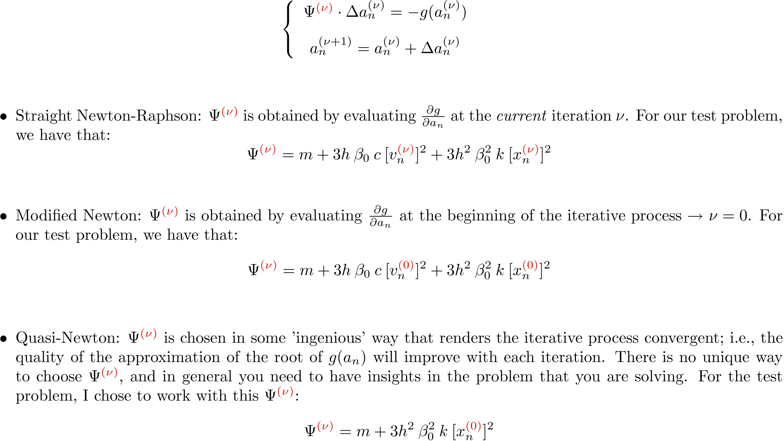
Newton-Type Methods [Algorithmic Formulation]

Slide 5
Exercise [Part 1 of 3]
MATLAB code available online, under “Resources”:
Newton Methods, MATLAB codes: [Newton-Raphson] [Modified-Newton] [Quasi-Newton].
http://sbel.wisc.edu/Courses/ME751/2010/Documents/MATLAB/massSpringDamperNR.m

Slide 6
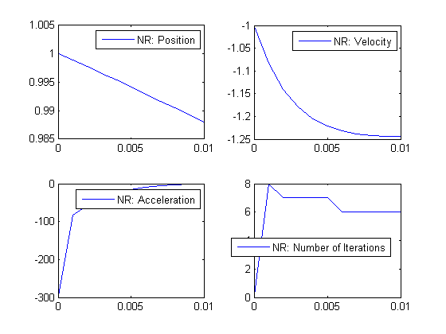
Newton-Raphson
while itCount < itCountMax,
v_new = v_old + sSize*a_new;
x_new = x_old + sSize*v_new;
% Get the residual, Jacobian, and correction
residual = m*a_new + c*v_old*v_new*v_new + k*x_new*x_new*x_new - sin(2*crntTime);
psiVal = m + 3*c*v_new*v_new*sSize + 3*k*x_new*x_new*sSize*sSize;
deltaAcc = -residual/psiVal;
% Apply correction
a_new = a_new + deltaAcc;
if abs(deltaAcc) < epsAcc
break;
end
itCount = itCount + 1;
end

Slide 7
Exercise [Part 2 of 3]
MATLAB code available online, under “Resources”:
Newton Methods, MATLAB codes: [Newton-Raphson] [Modified-Newton] [Quasi-Newton].
http://sbel.wisc.edu/Courses/ME751/2010/Documents/MATLAB/massSpringDamperNR.m

Slide 8
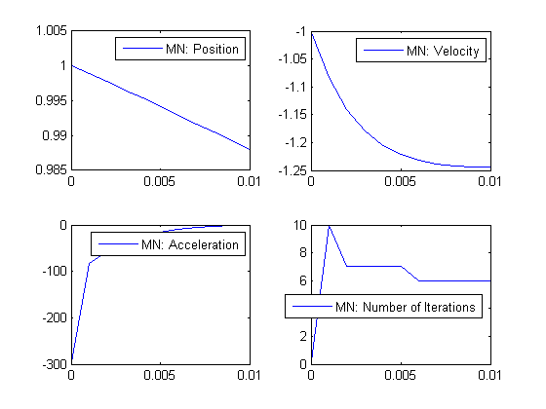
Modified-Newton
while itCount < itCountMax,
v_new = v_old + sSize*a_new;
x_new = x_old + sSize*v_new;
% Compute Jacobian once per times, for nu=0
if itCount==1
psiVal = m + 3*c*v_new*v_new*sSize + 3*k*x_new*x_new*sSize*sSize;
end
% Get the residual and the correction
residual = m*a_new + c*v_old*v_new*v_new + k*x_new*x_new*x_new - sin(2*crntTime);
deltaAcc = -residual/psiVal;
% Apply correction
a_new = a_new + deltaAcc;
if abs(deltaAcc) < epsAcc
break;
end
itCount = itCount + 1;
end

Slide 9
Exercise [Part 3 of 3]
MATLAB code available online, under “Resources”:
Newton Methods, MATLAB codes: [Newton-Raphson] [Modified-Newton] [Quasi-Newton].
http://sbel.wisc.edu/Courses/ME751/2010/Documents/MATLAB/massSpringDamperNR.m

Slide 10
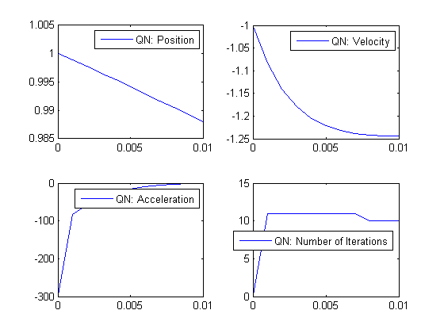
Quasi-Newton
while itCount < itCountMax,
v_new = v_old + sSize*a_new;
x_new = x_old + sSize*v_new;
% Compute Jacobian once per times, for nu=0
if itCount==1
%psiVal = m + 3*c*v_new*v_new*sSize + 3*k*x_new*x_new*sSize*sSize;
psiVal = m + 3*k*x_new*x_new*sSize*sSize;
end
% Get the residual and the correction
residual = m*a_new + c*v_old*v_new*v_new + k*x_new*x_new*x_new - sin(2*crntTime);
deltaAcc = -residual/psiVal;
% Apply correction
a_new = a_new + deltaAcc;
if abs(deltaAcc) < epsAcc
break;
end
itCount = itCount + 1;
end

Slide 11
The BDF Solution of the Dynamics Analysis Problem

Slide 12
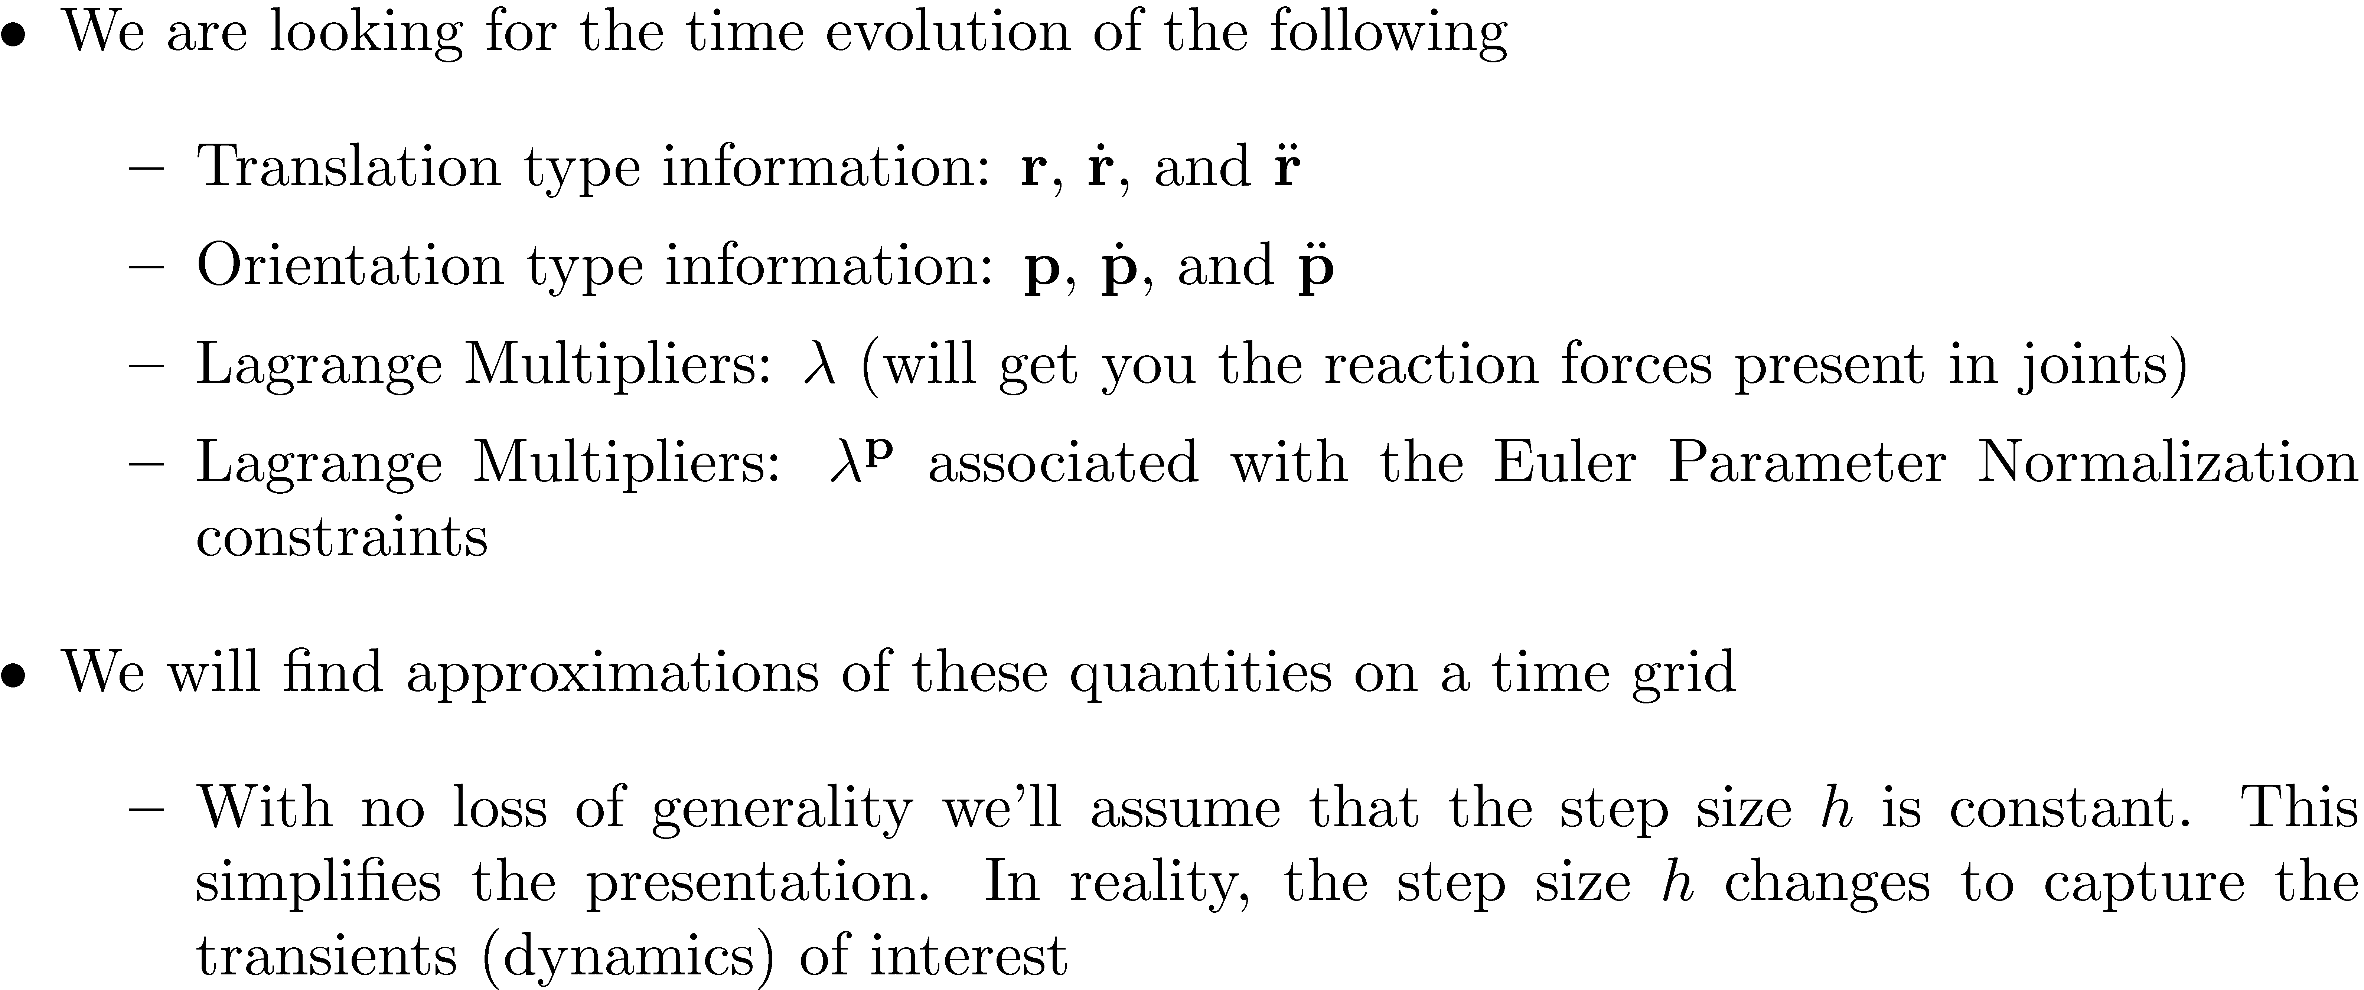
Framework, Dynamics Analysis Problem

Slide 13
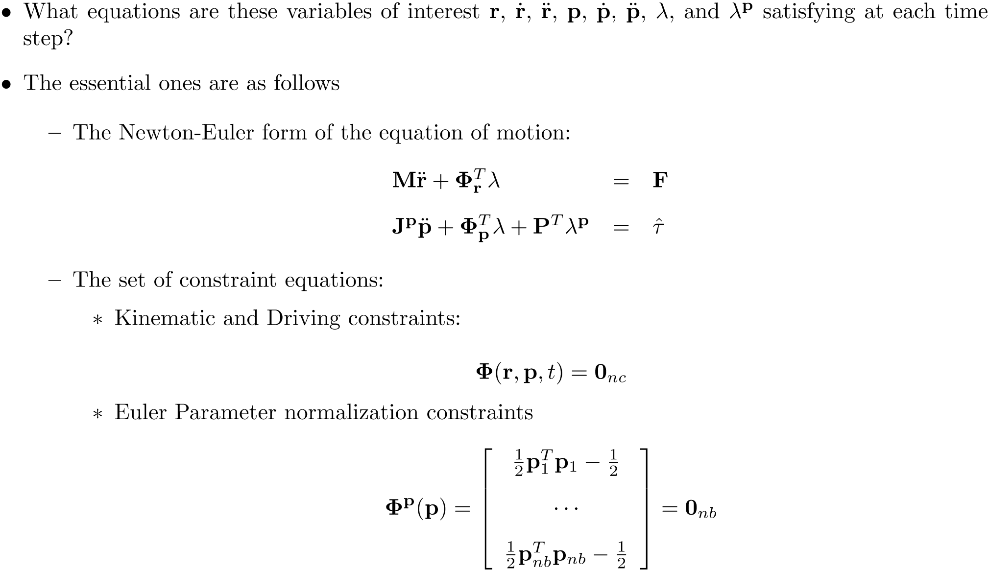
The Dynamics Problem - Essential Equations [The Main Characters]

Slide 14
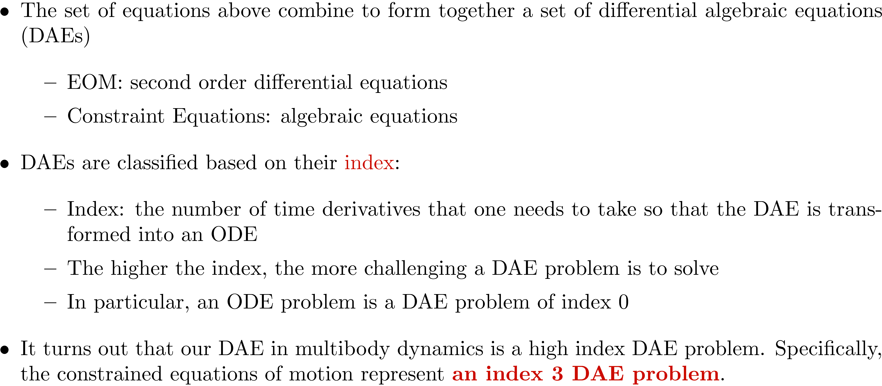
Differential Algebraic Equations (DAEs)

Slide 15
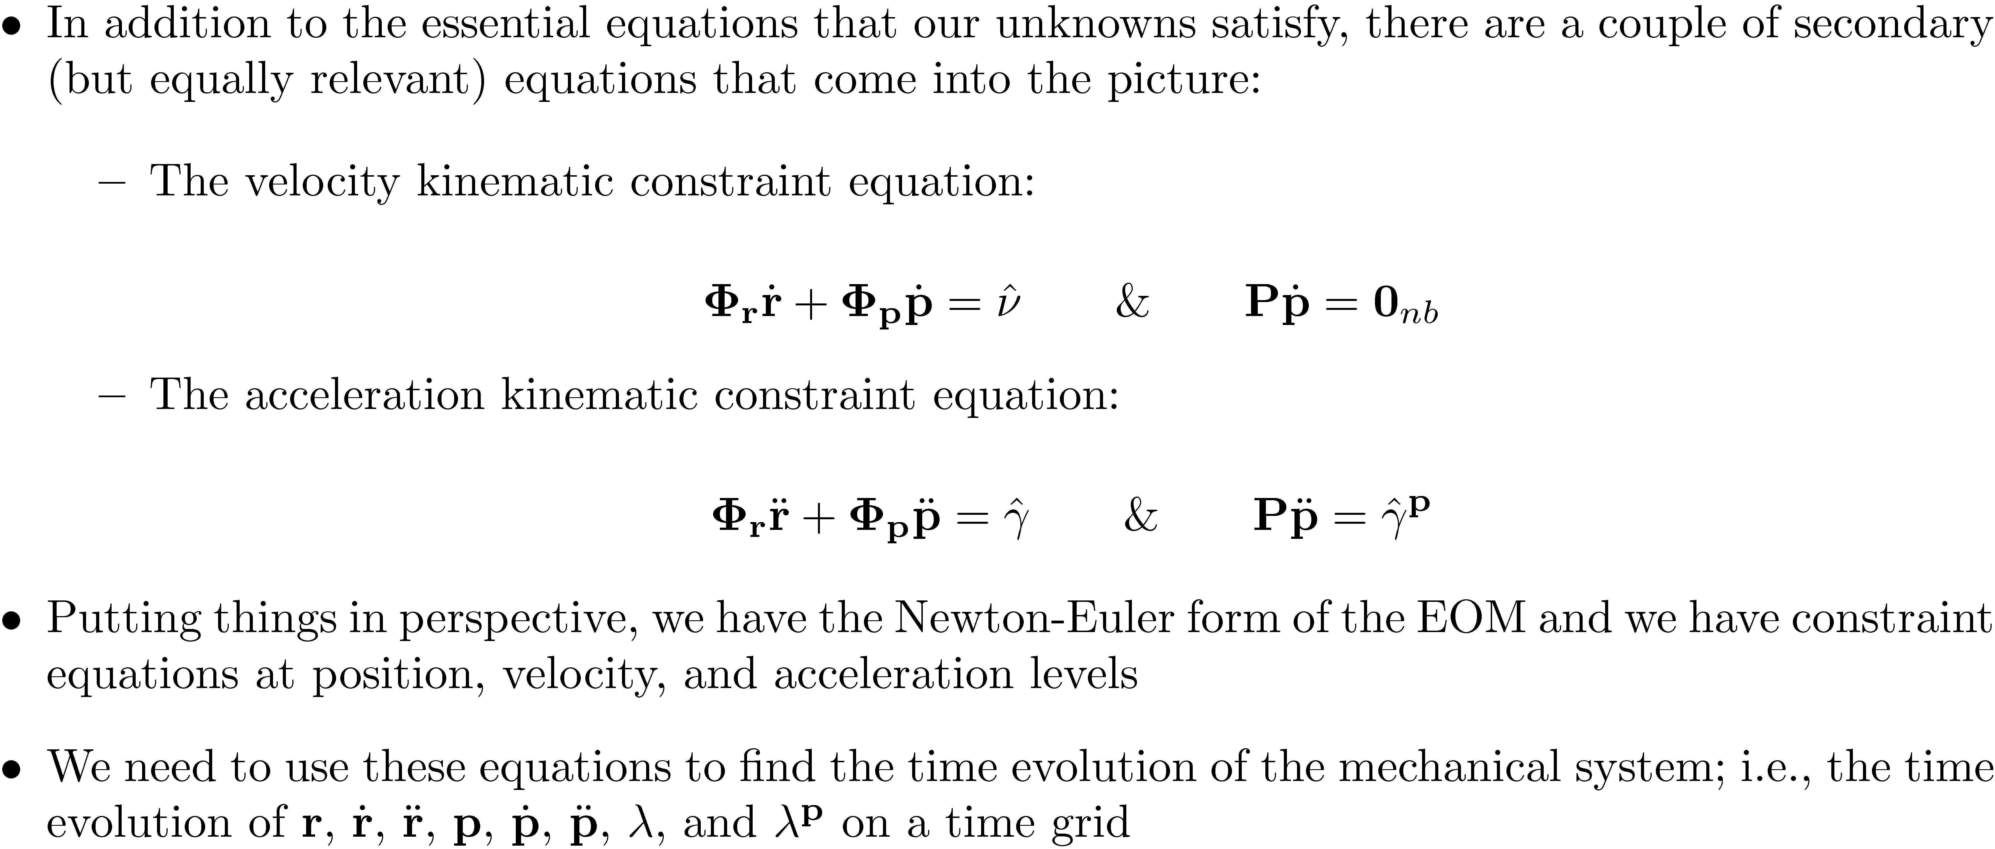
The Dynamics Problem [The Rest of the Cast]

Slide 16
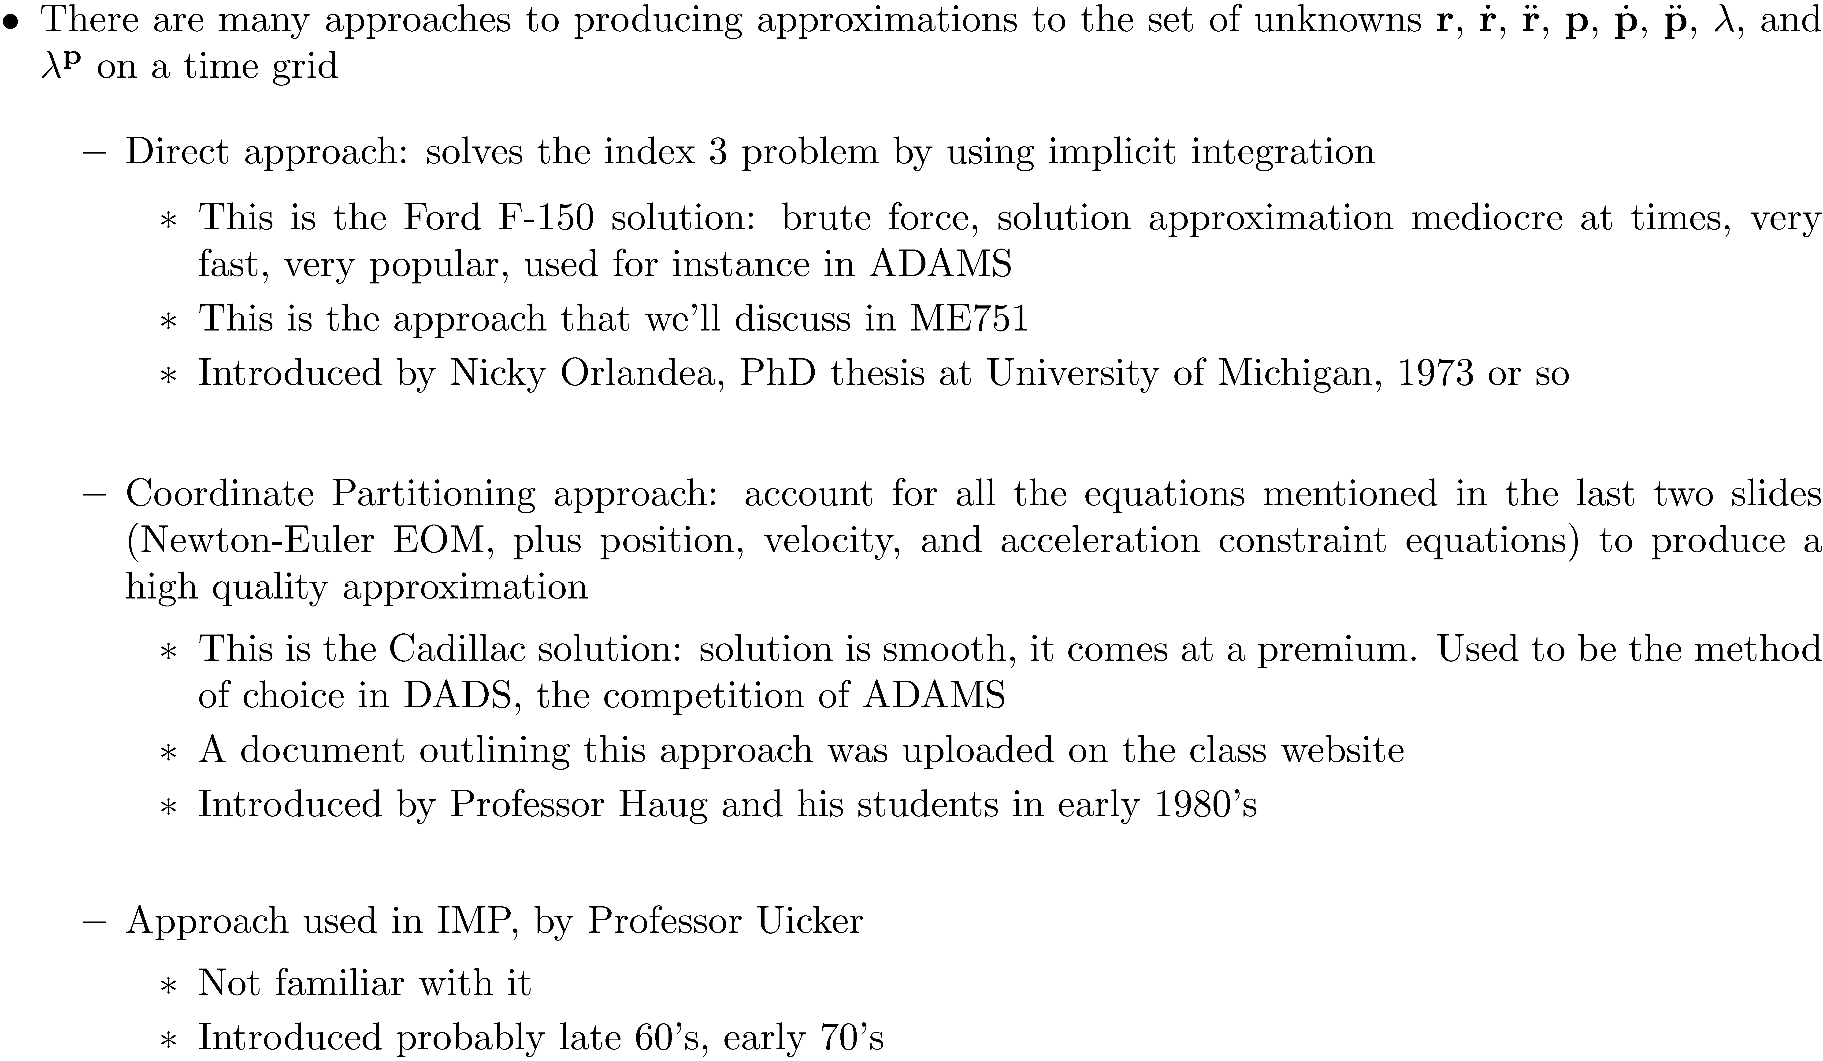
Finding a Numerical Solution for the Dynamics Analysis Problem

Slide 17
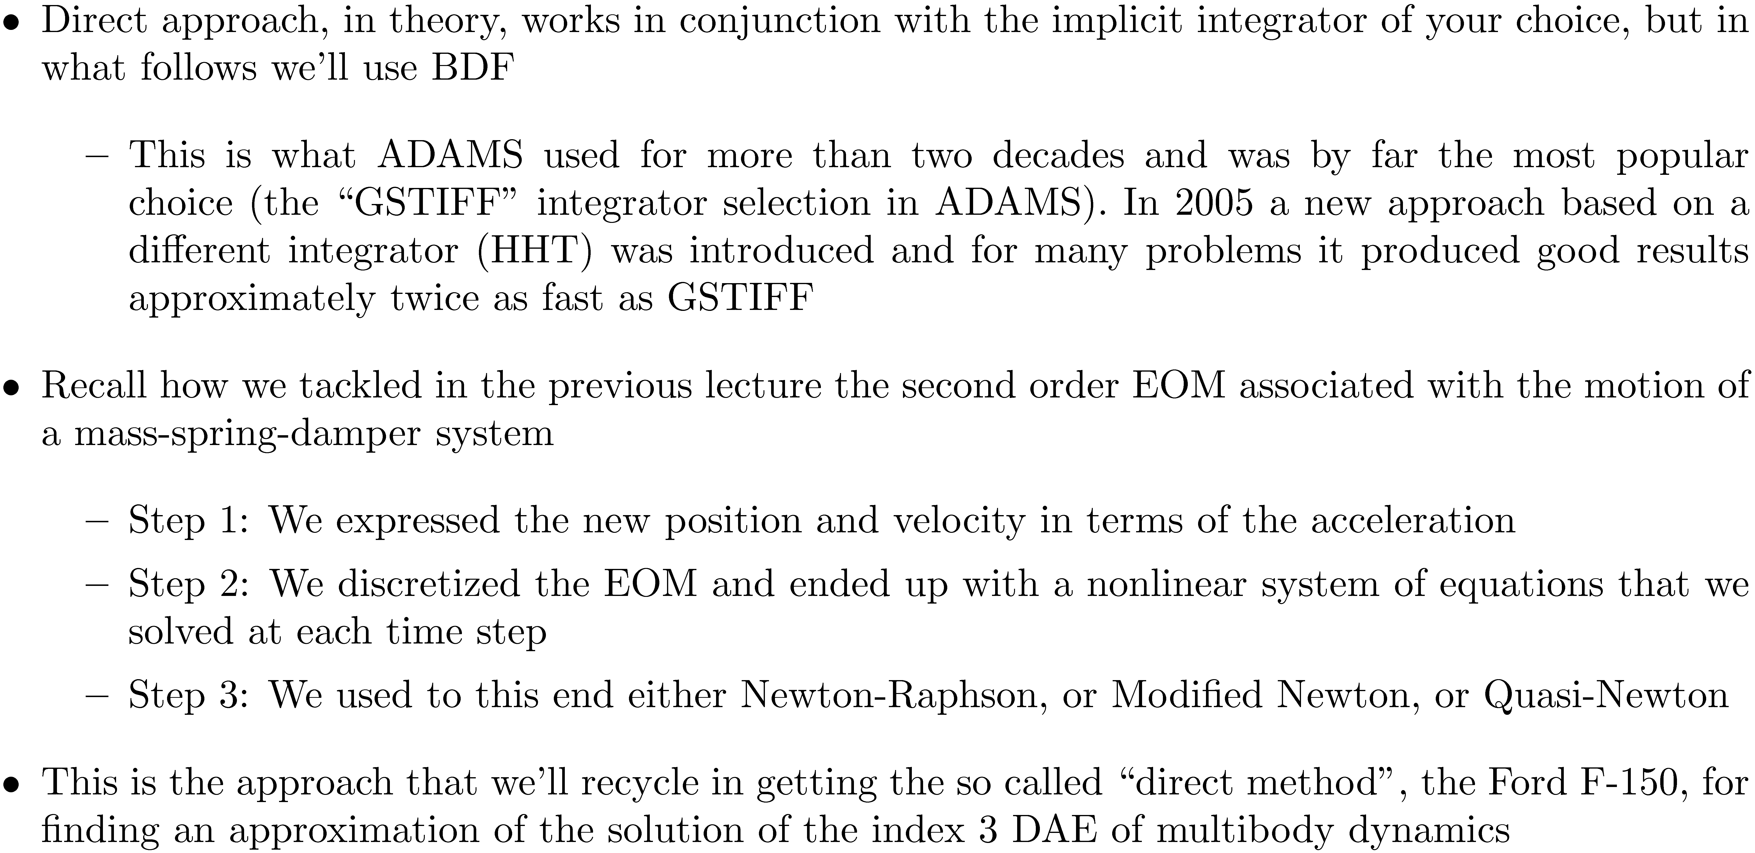
The Direct Approach [Ford F-150]

Slide 18
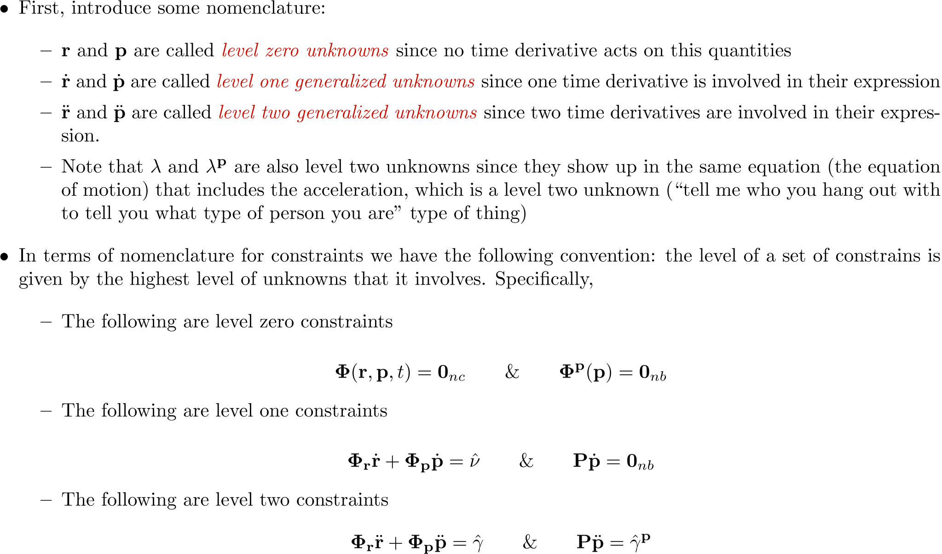
Nomenclature [Re: Unknowns and Equations]

Slide 19
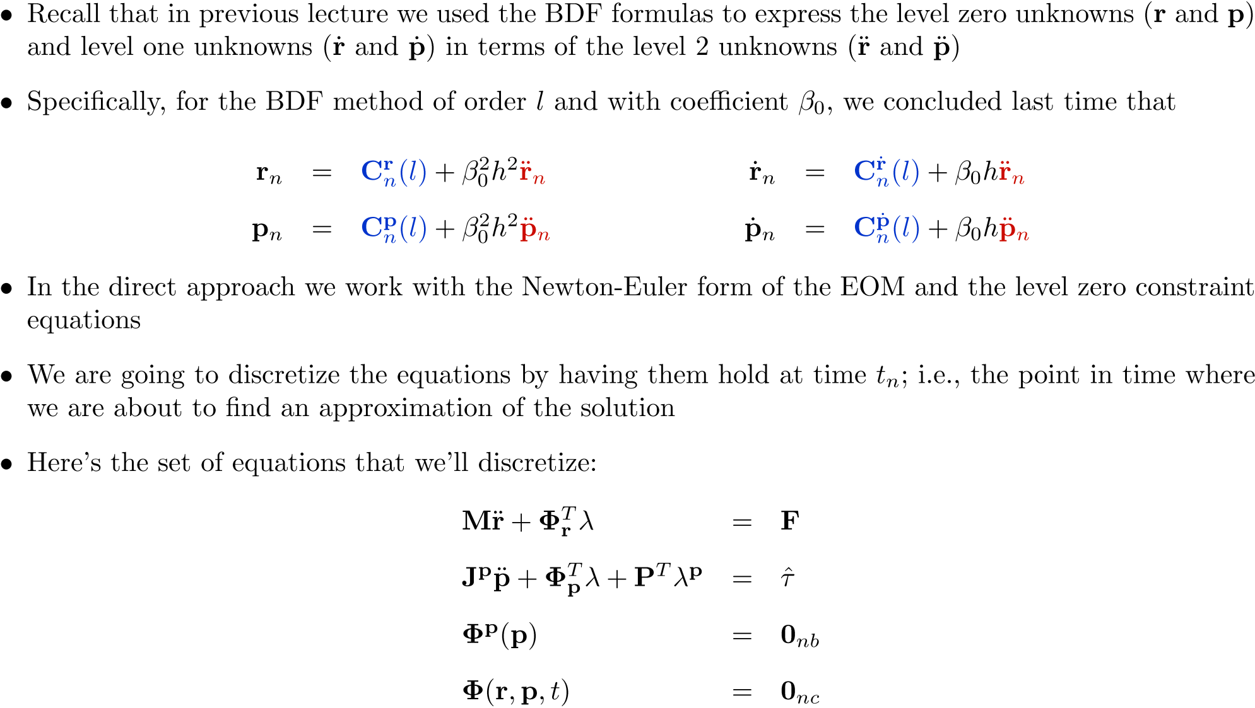
Direct Approach: Step 1

Slide 20
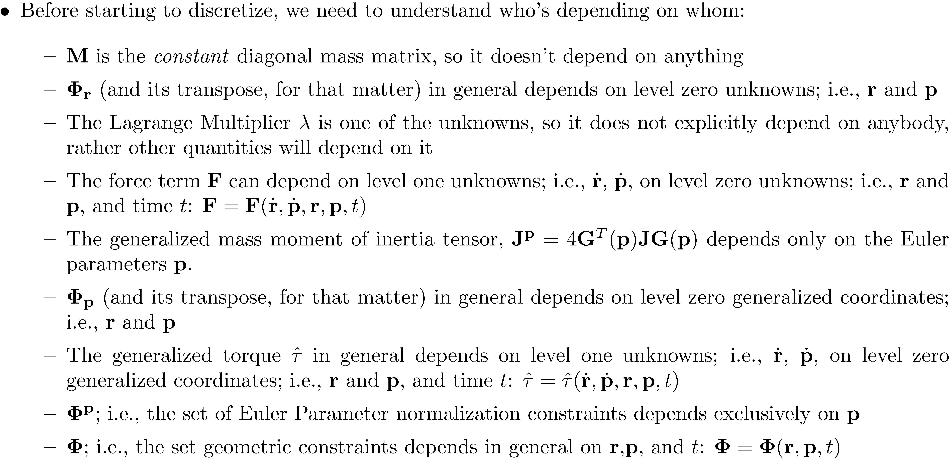
Direct Approach: Step 1 [Cntd.]

Slide 21
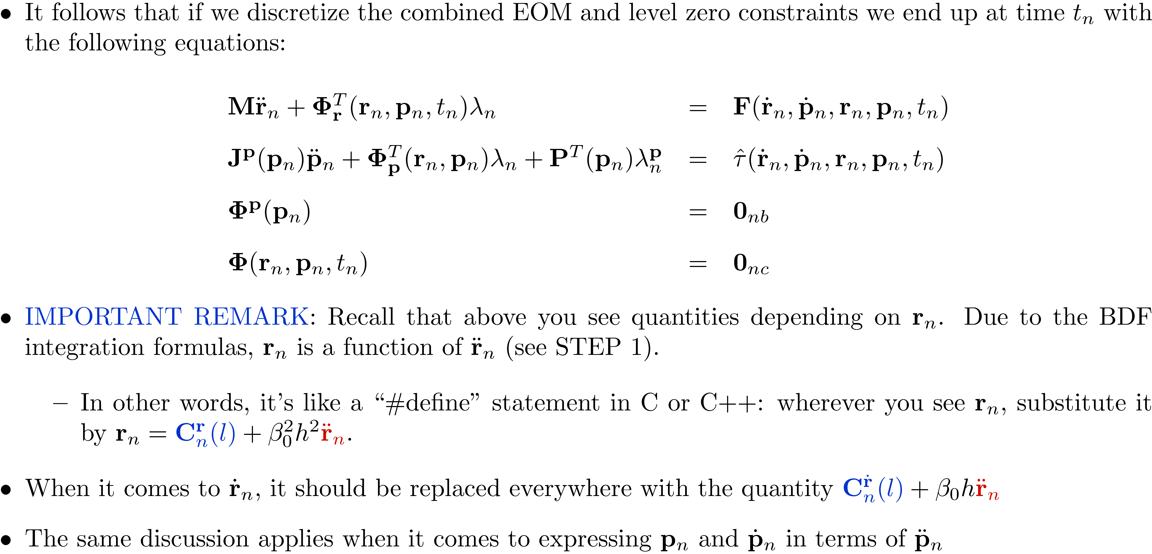
Direct Approach: Step 2

Slide 22
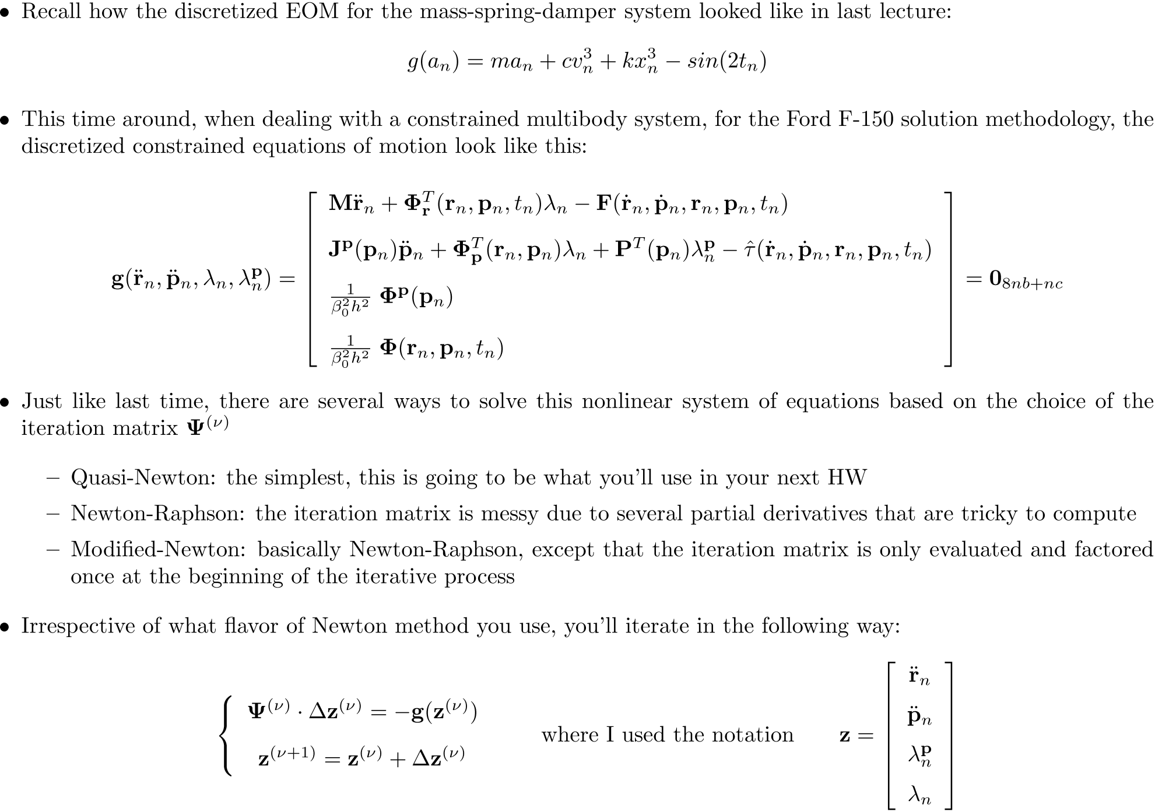
Direct Approach: Step 3

Slide 23
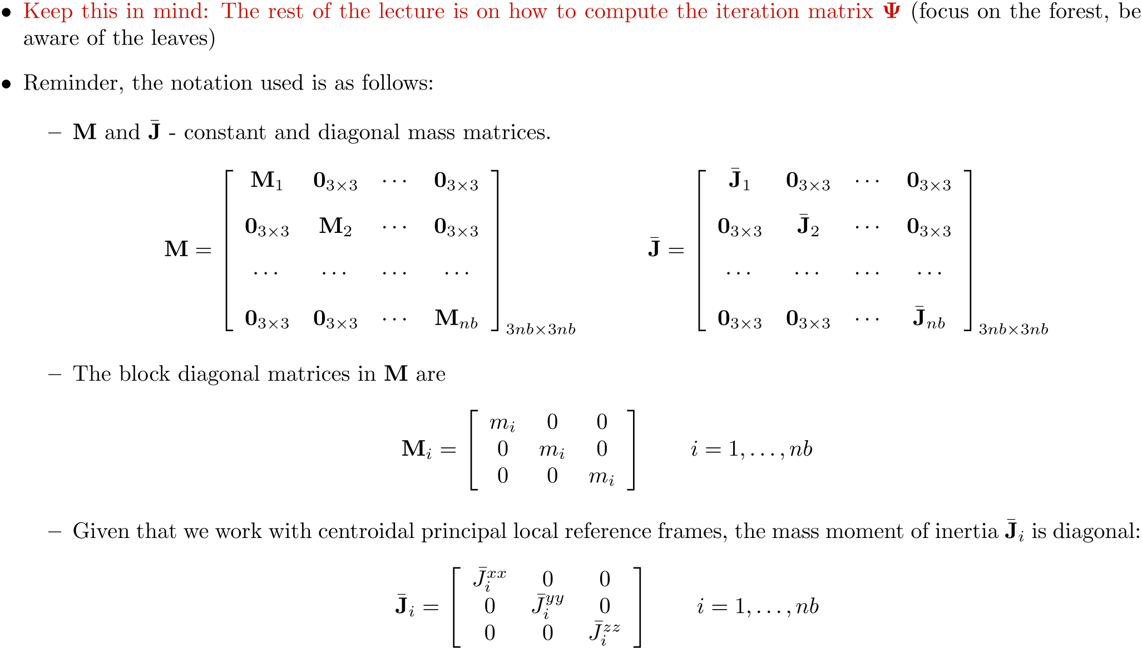
Direct Approach: Step 3 [The Gory Details]

Slide 24
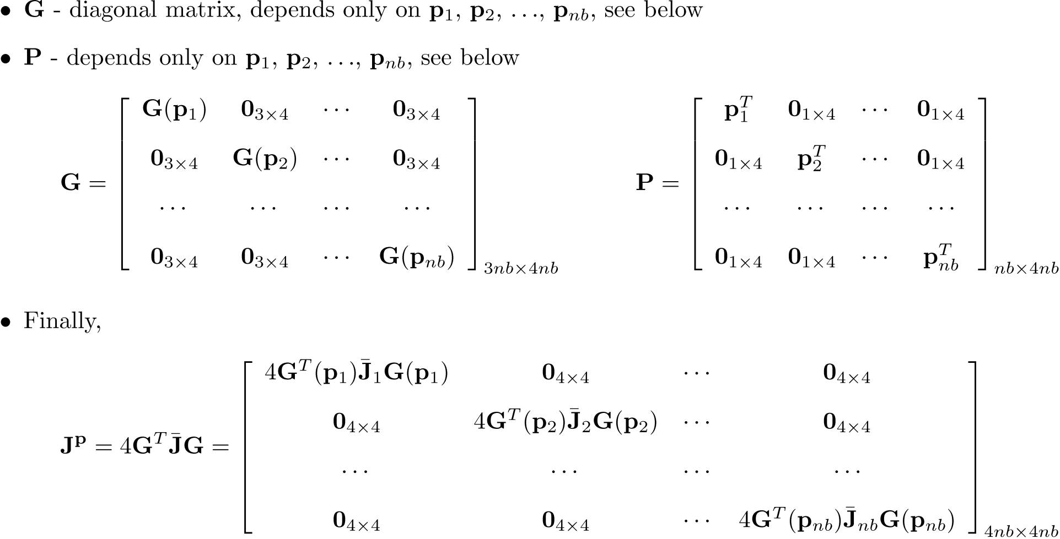
Direct Approach: Step 3 [The Gory Details, Cntd.]

Slide 25
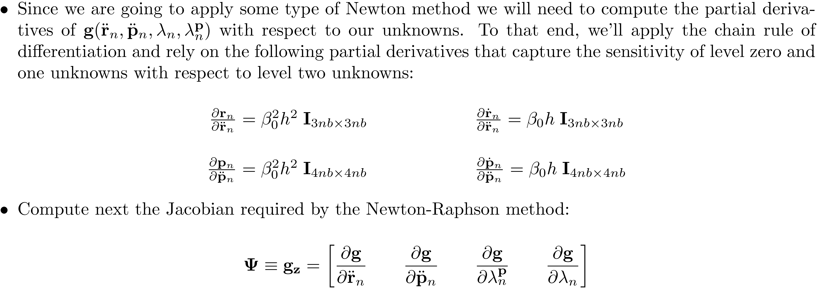
Sensitivities of Level 0 and 1 Unknowns wrt Level 2 Unknowns [Step 3, Details]

Slide 26
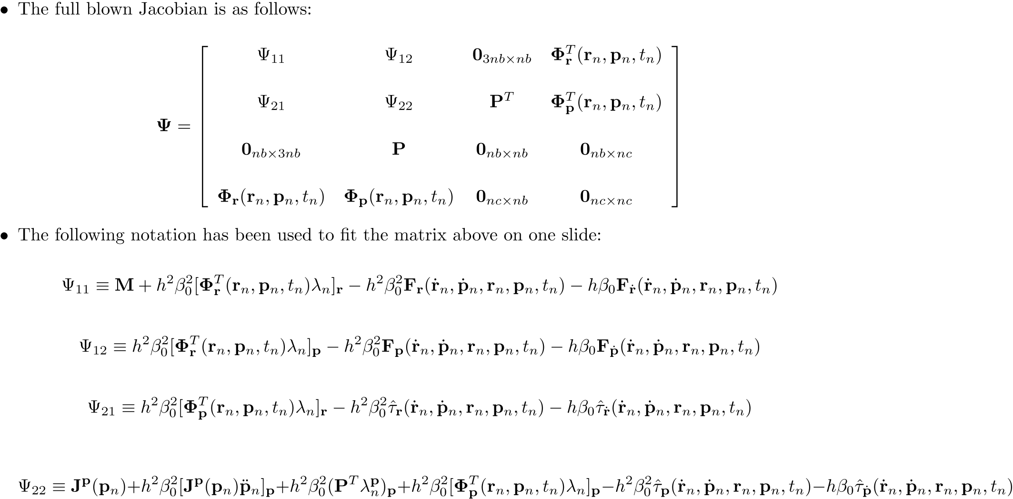
The Full-Blown Newton-Raphson Iteration Matrix [Step 3, Details]

Slide 27
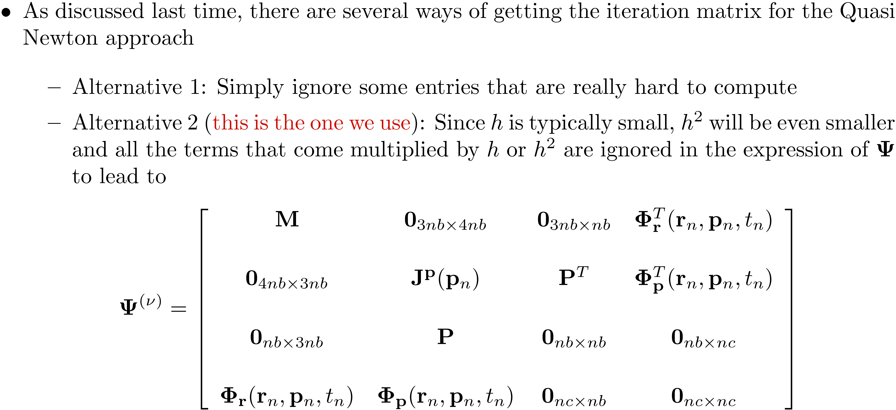
The Quasi-Newton Iteration Matrix [Step 3, Details]

Slide 28
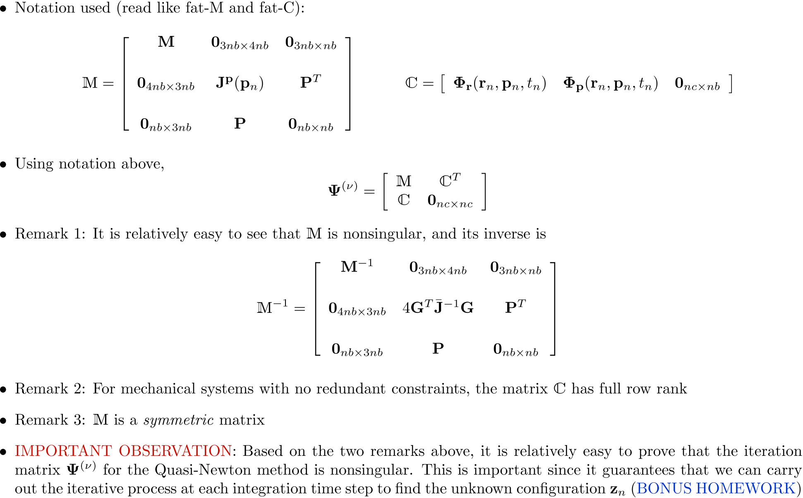
The Quasi-Newton Iteration Matrix [Step 3, Details]

Slide 29
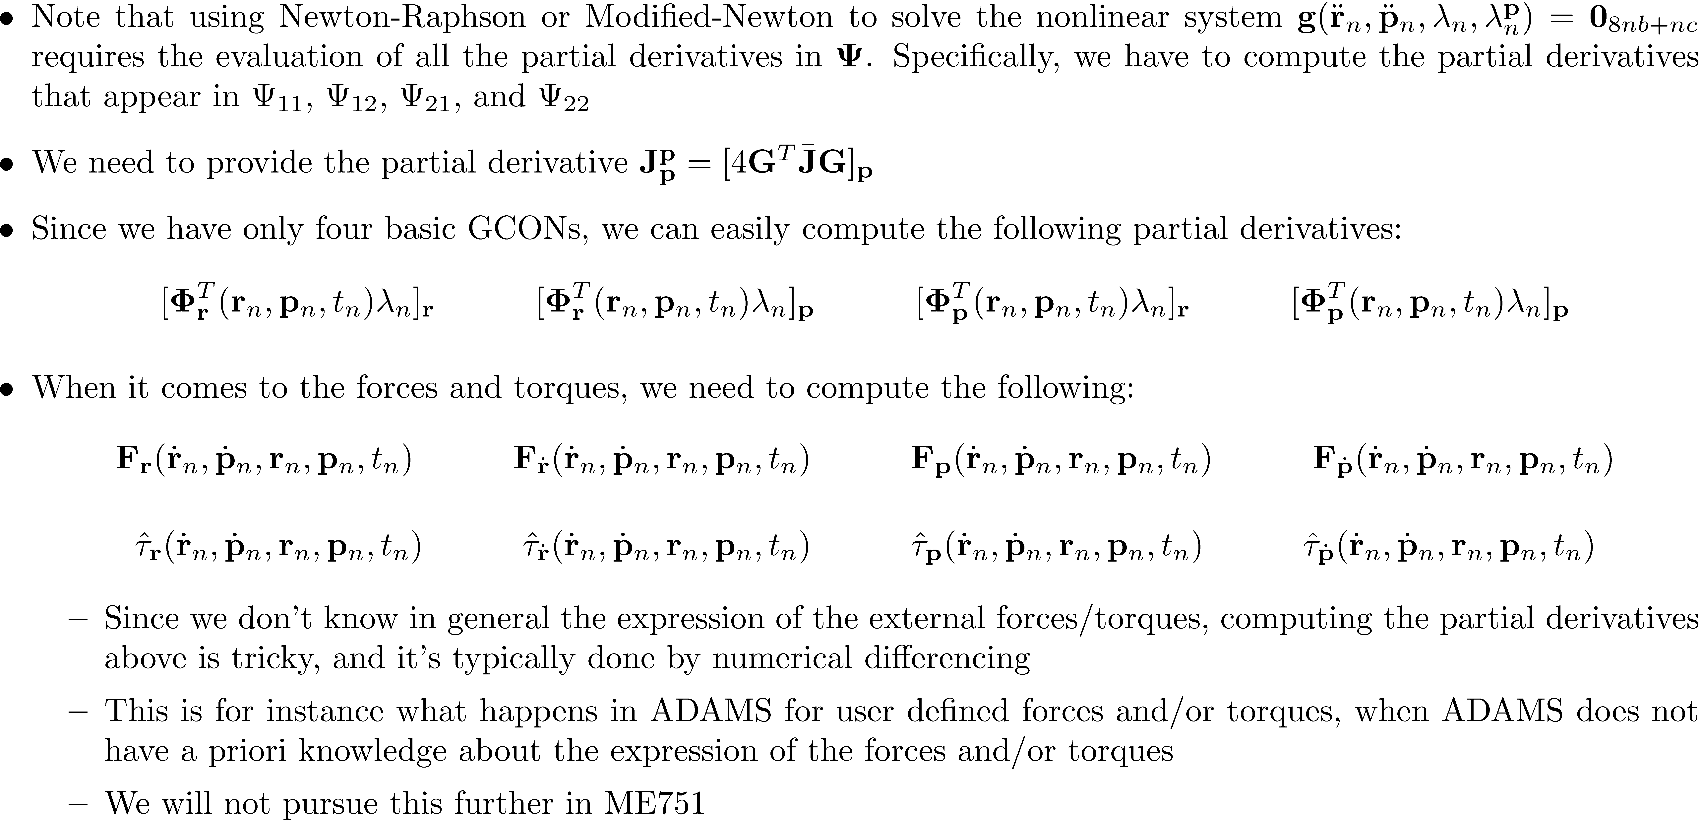
The Newton-Raphson and Modified-Newton Iteration Matrix [Step 3, Details of the Details]

